Slide 1

STOP THE GEARS FROM TURNING

Slide 2
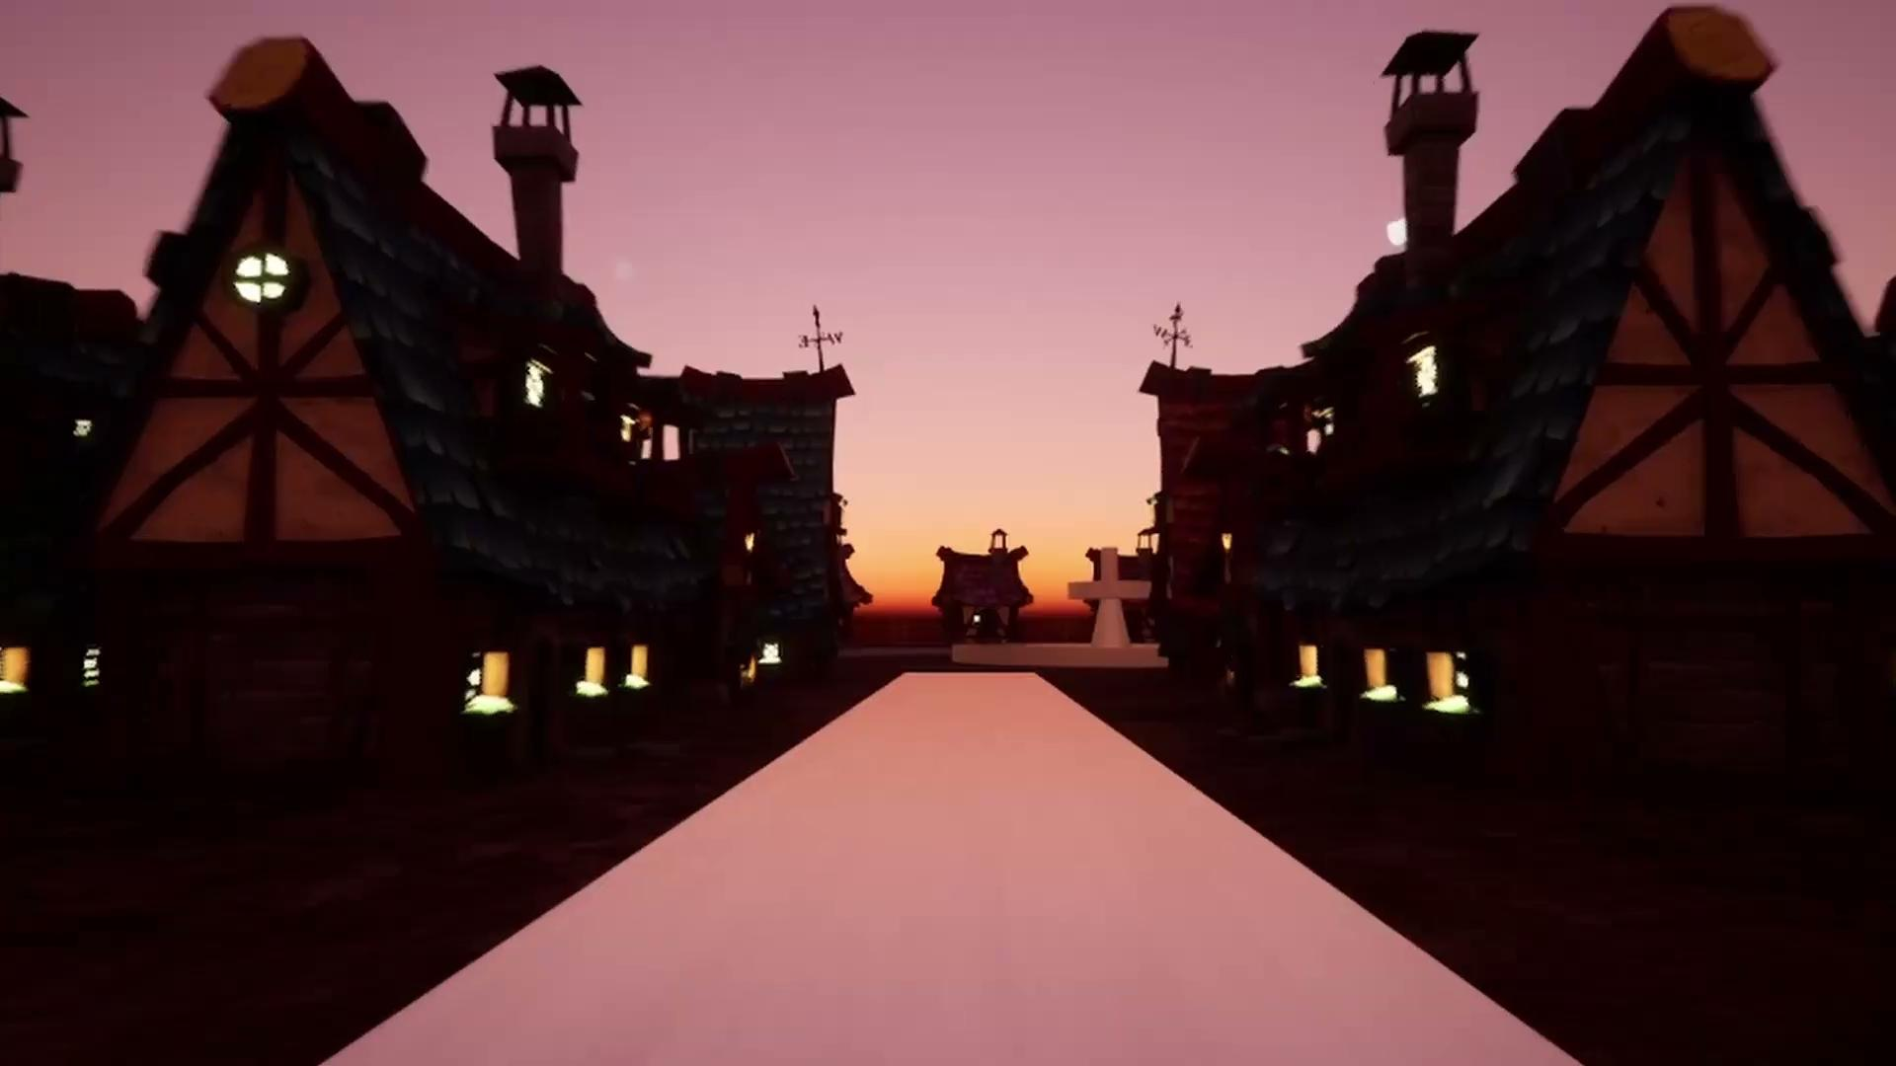

Slide 3
Story
Ella, Jacob, Ronak, Arpeet, Ani, Ethan, Toby

Slide 4
STORY INSPIRATION
Steampunk
MECHS
Industrial revolution style inspiration for the technology, mechanisms, and design
Science fiction twist with mechs (robot fighting suits) and other fantasy elements

Slide 5
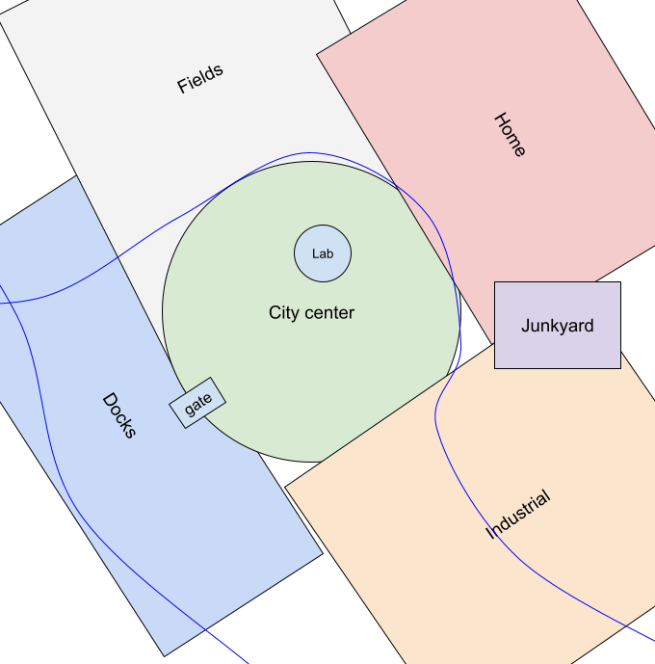
City Layout
City
Residential
Urban center which connects the districts
Starting area, player home and local shops
Docks
Industrial
Hub for trade, shipyards, and shipbuilding
Manufacturing district filled with factories

Slide 6
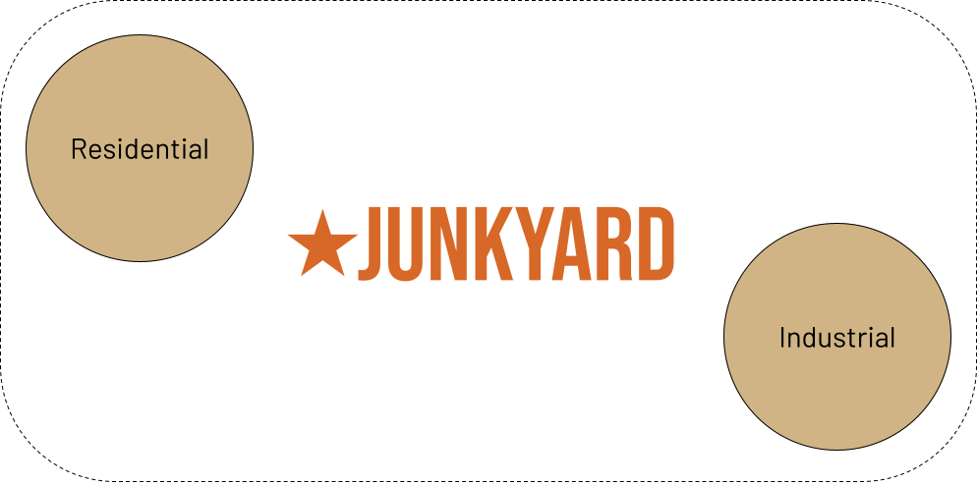
Start of game
Player
Exposition
Mech builder
Peaceful uneventful life
Shop tutorial for parts
Mech commission
Junkyard search for final part
First fight / combat tutorial

Slide 7
TIME
Stuck in the loop
The main motivation for the player to explore and engage in quests.

Slide 8
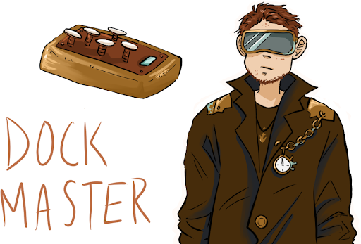
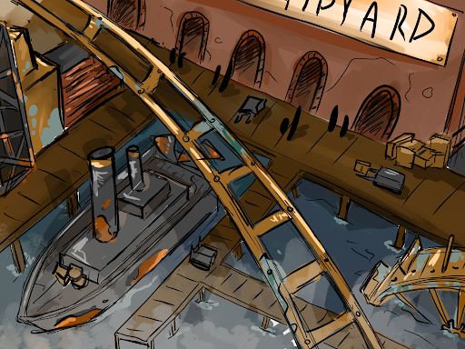
investigation
City center
Docks
industrial
Dock Master Lennard
MA boss fight

Slide 9
LAB
Cave
Creepy abandoned laboratory
Underground final boss area

Slide 10
Version Control
Jacob

Slide 11
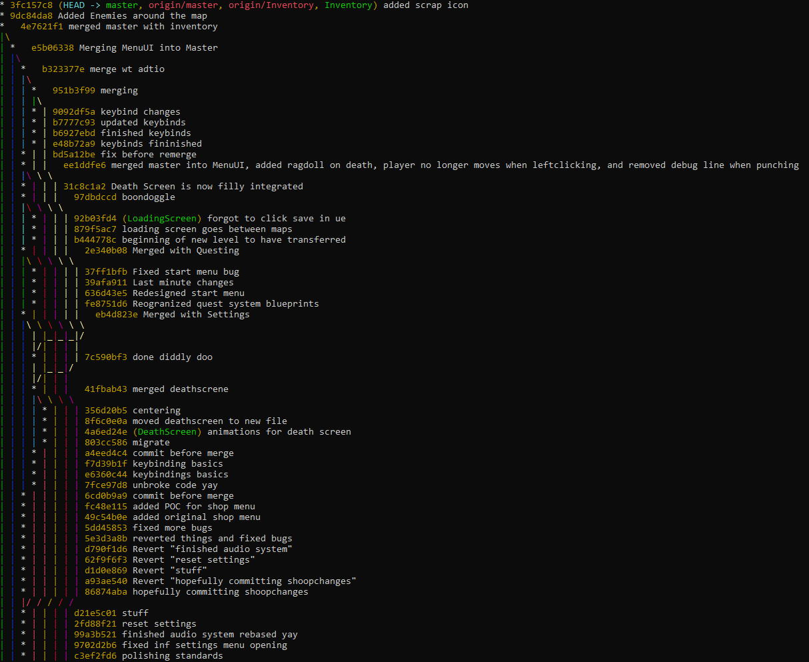
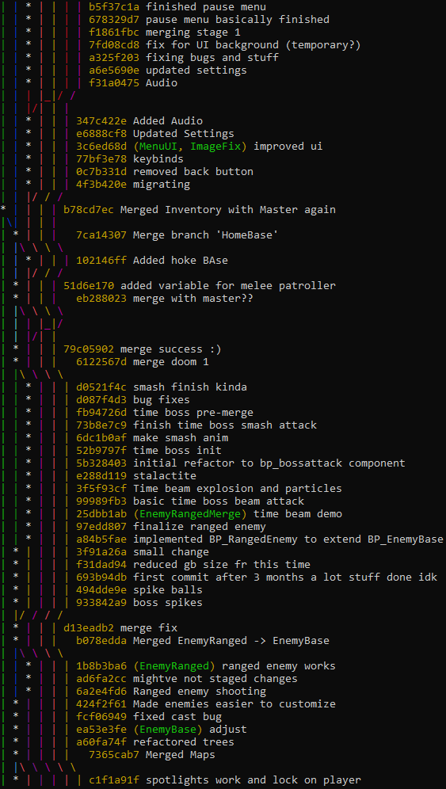
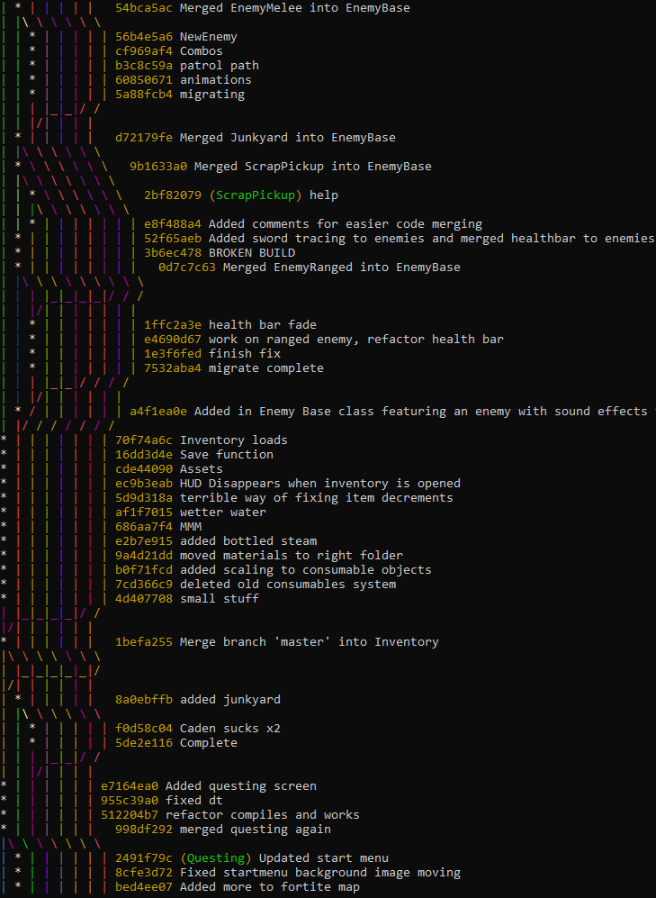
Version control

Slide 12
All Maps
Caden, Ella, Spencer, Ani

Slide 13
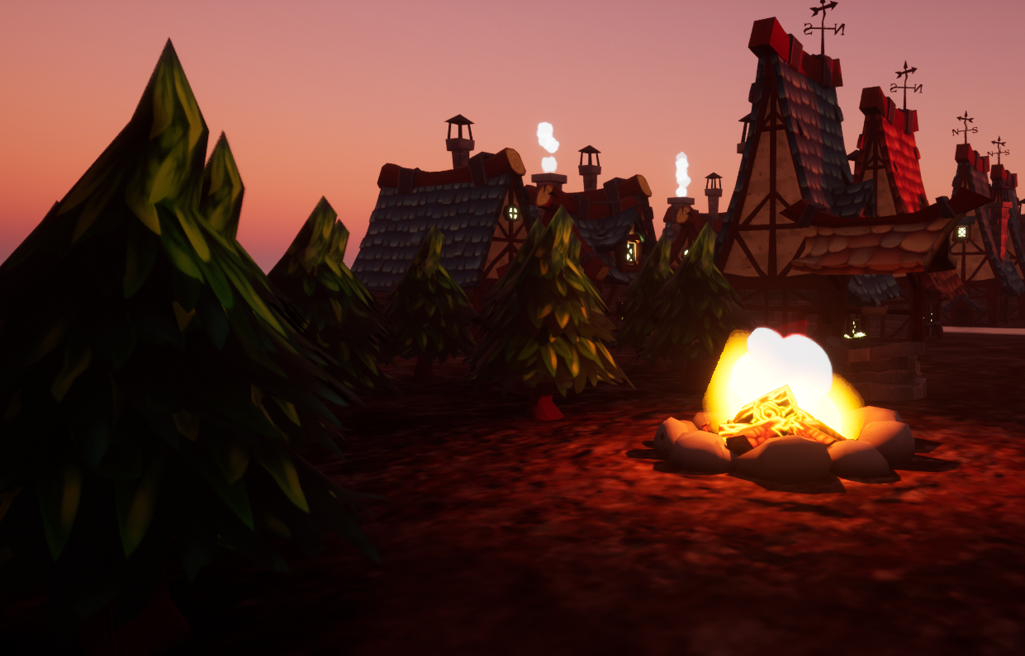
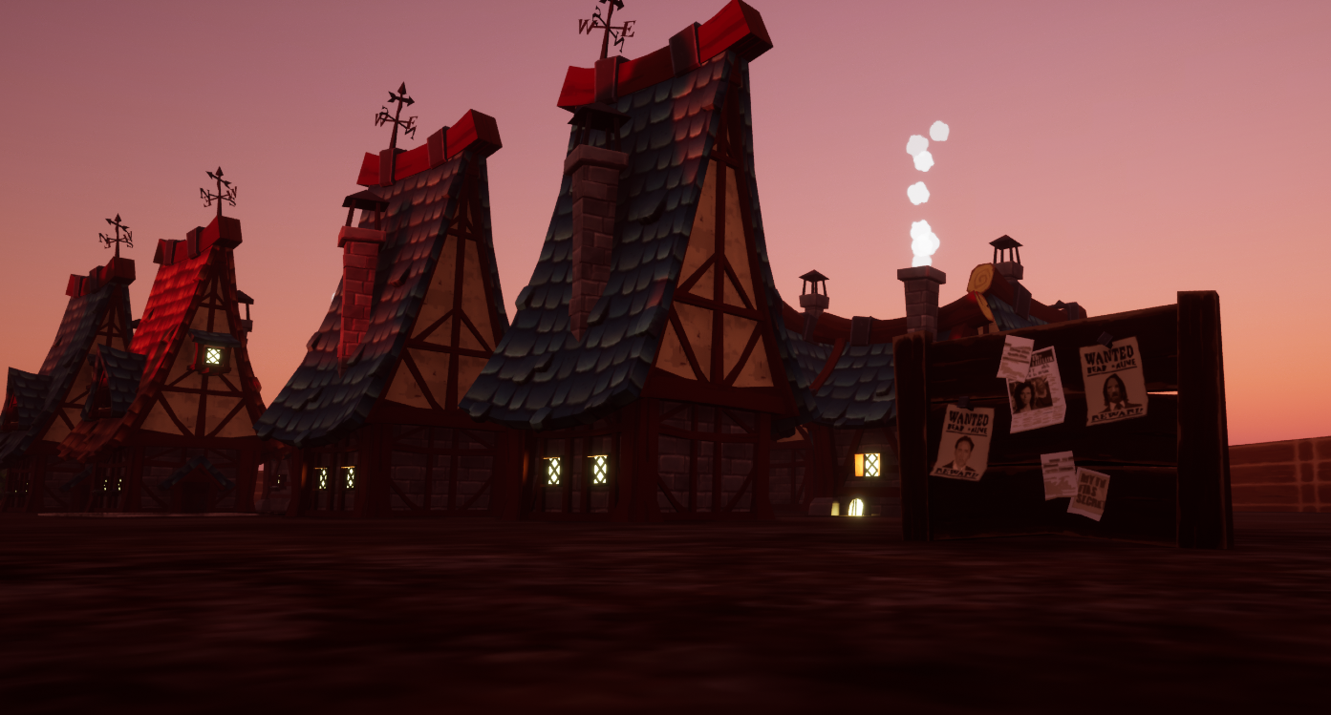
Maps

Slide 14
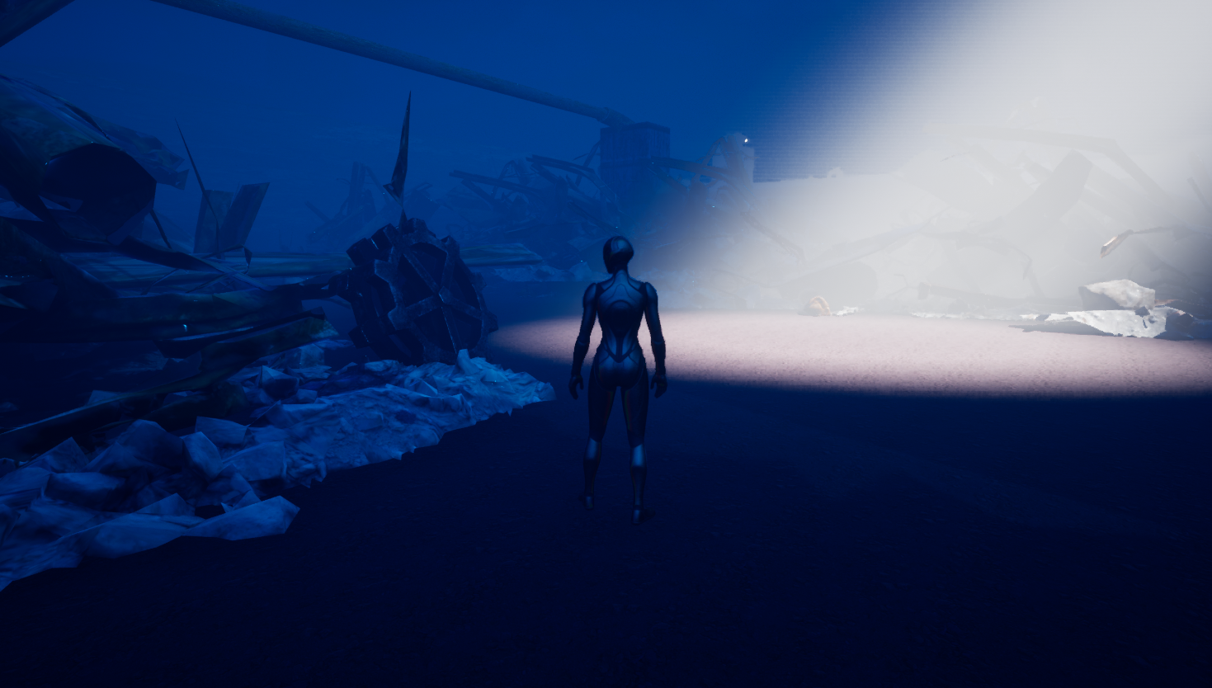
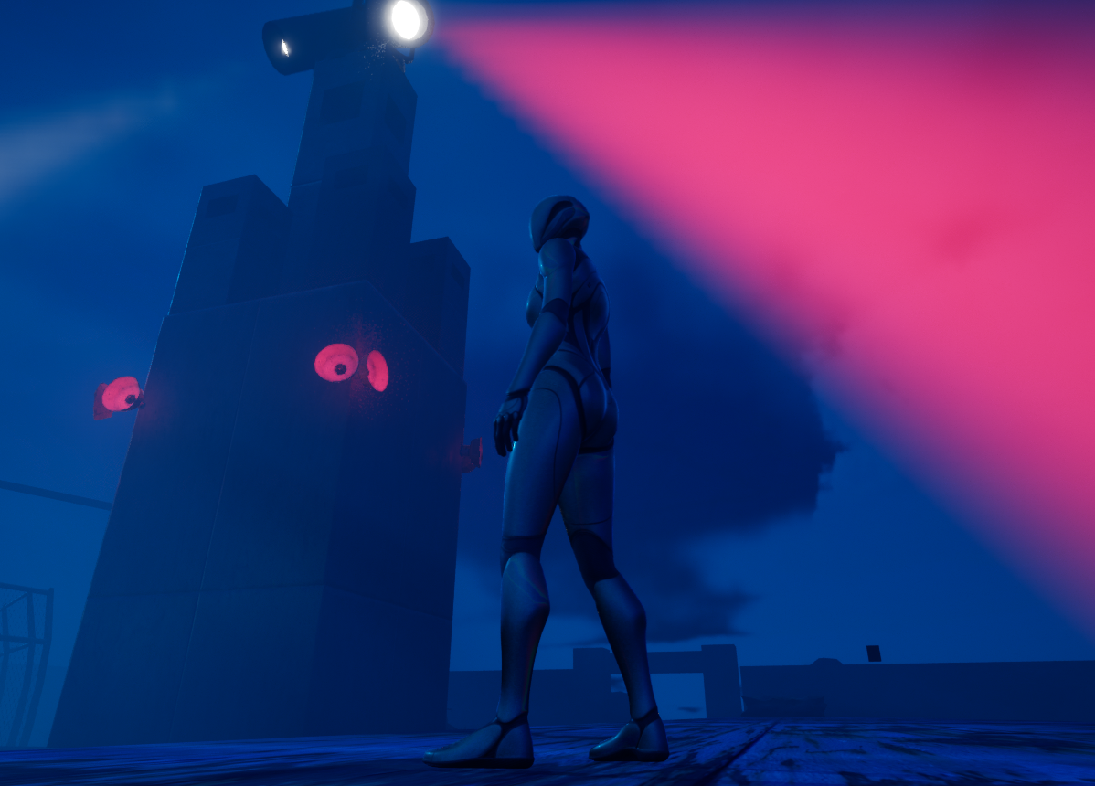
Maps

Slide 15
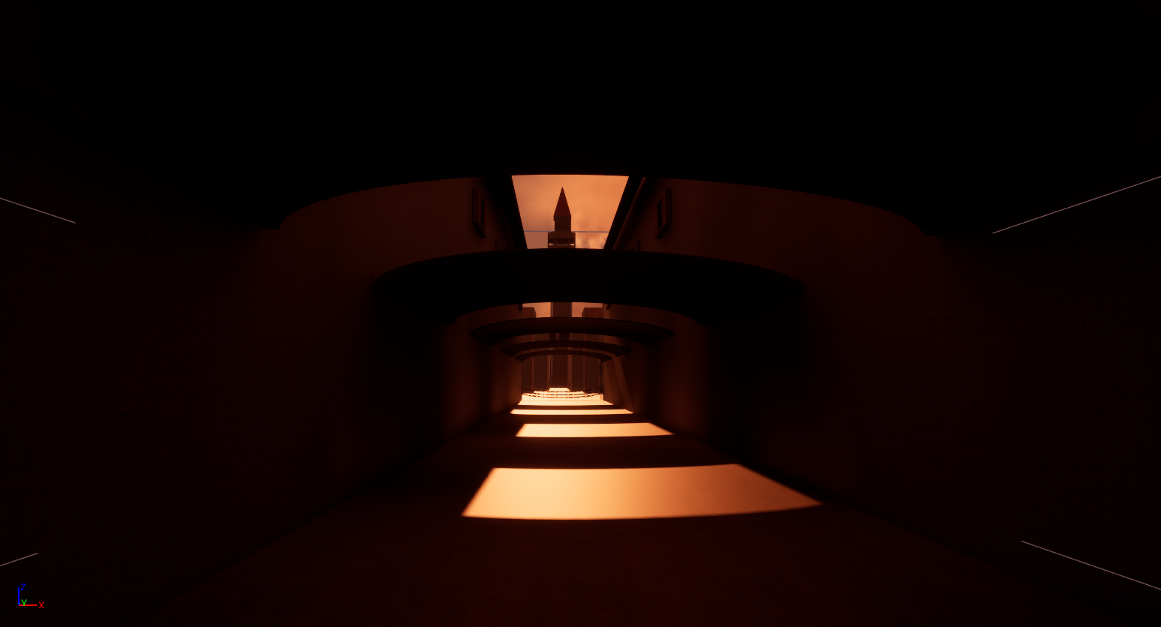
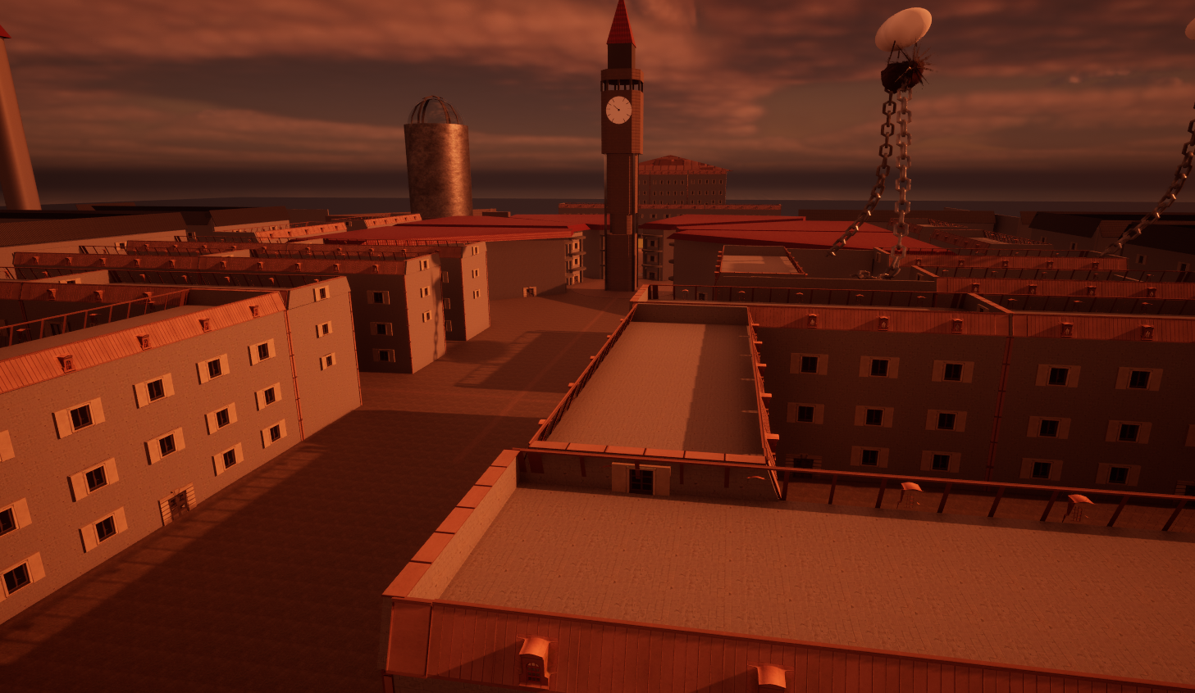
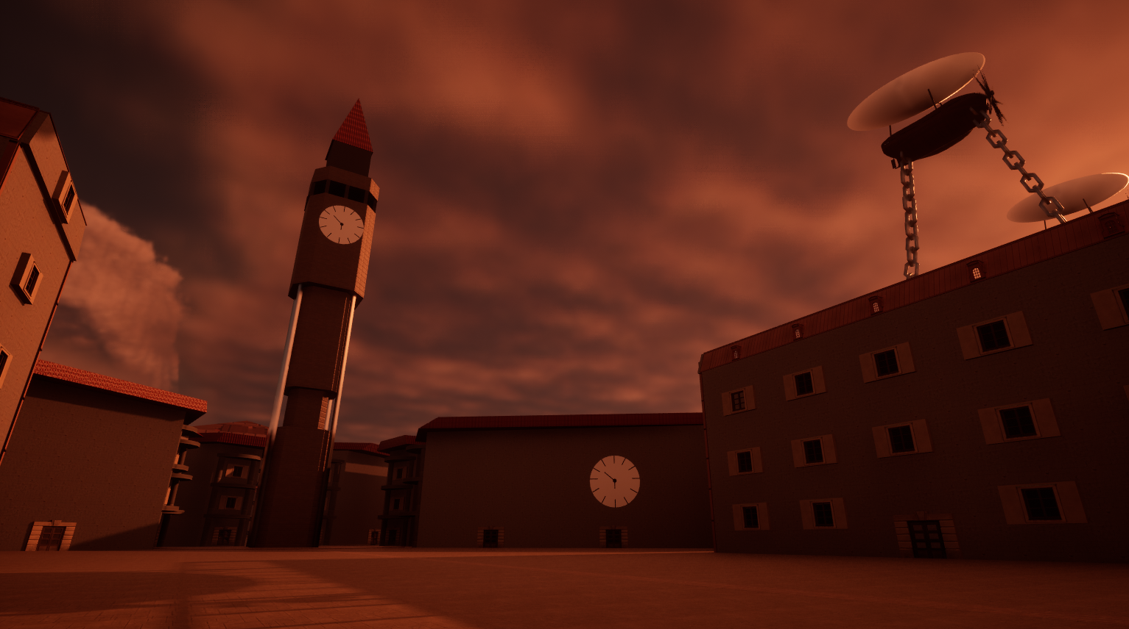
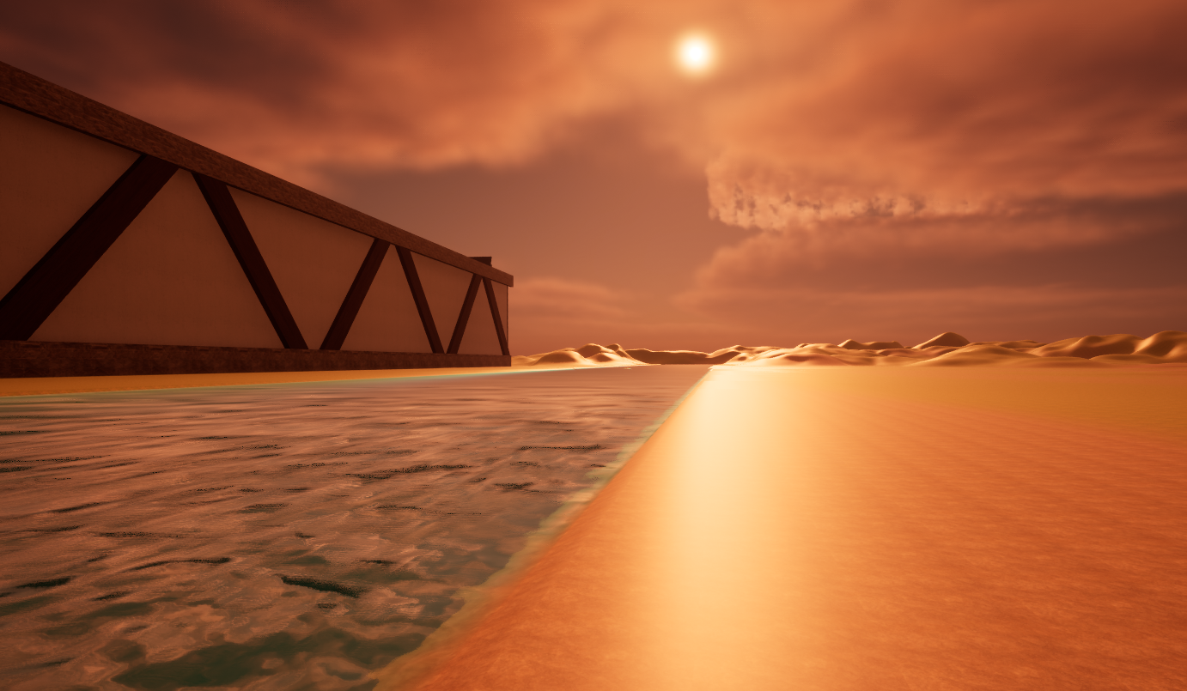
MAPS

Slide 16
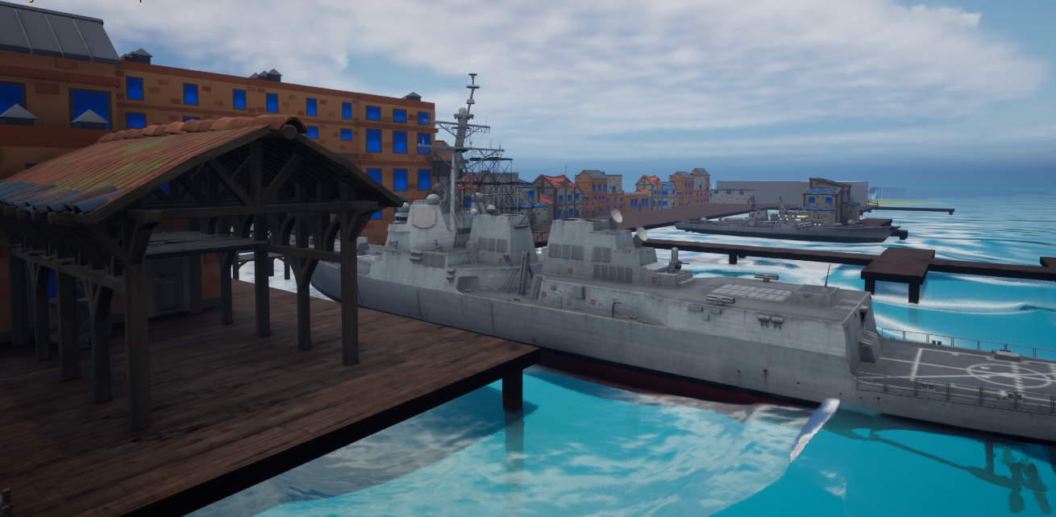
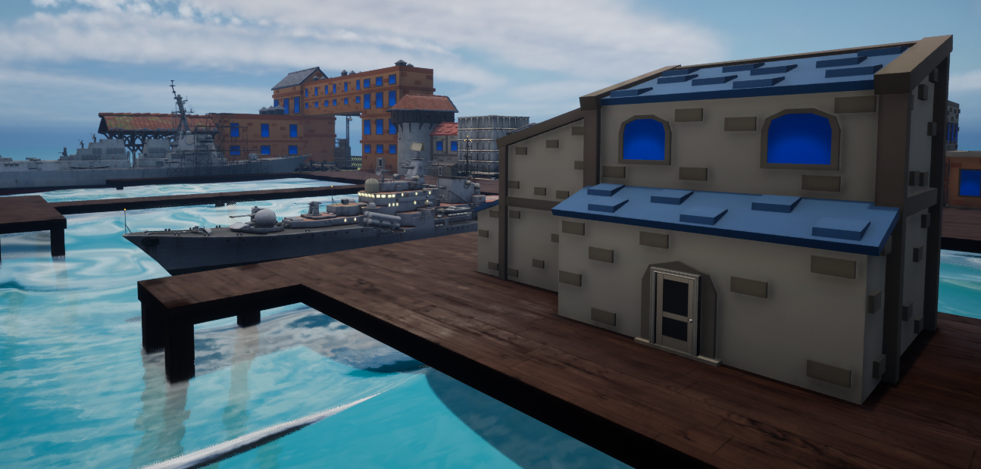
MAPS

Slide 17
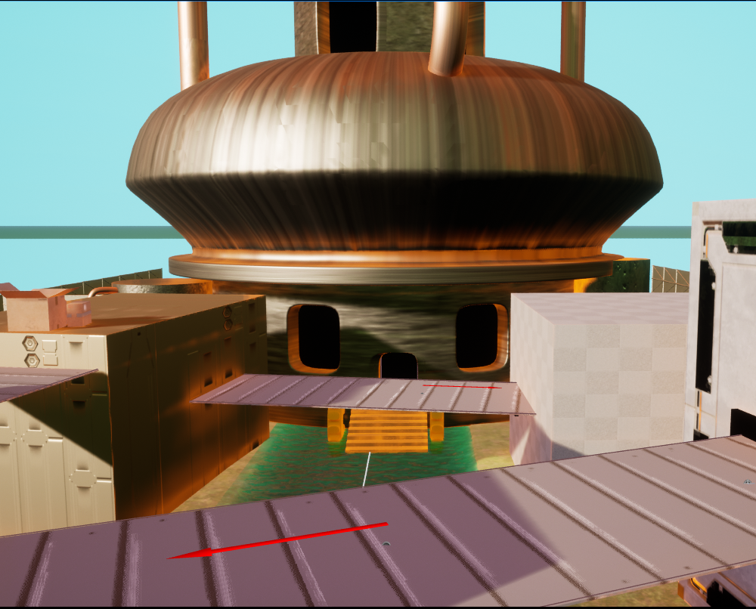
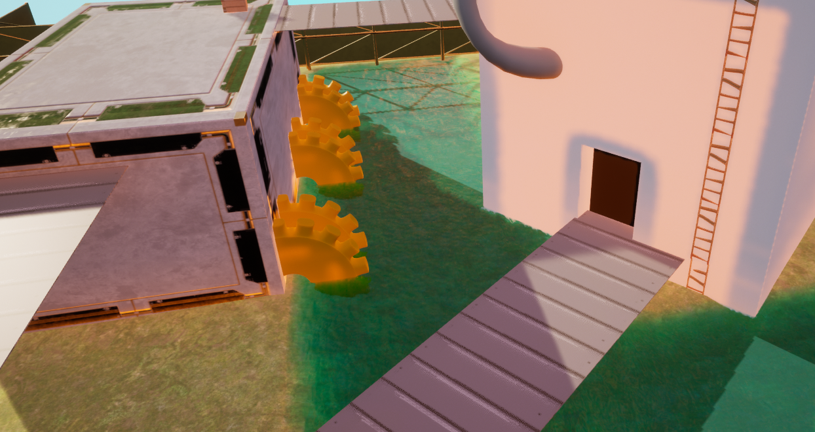

MAPS

Slide 18
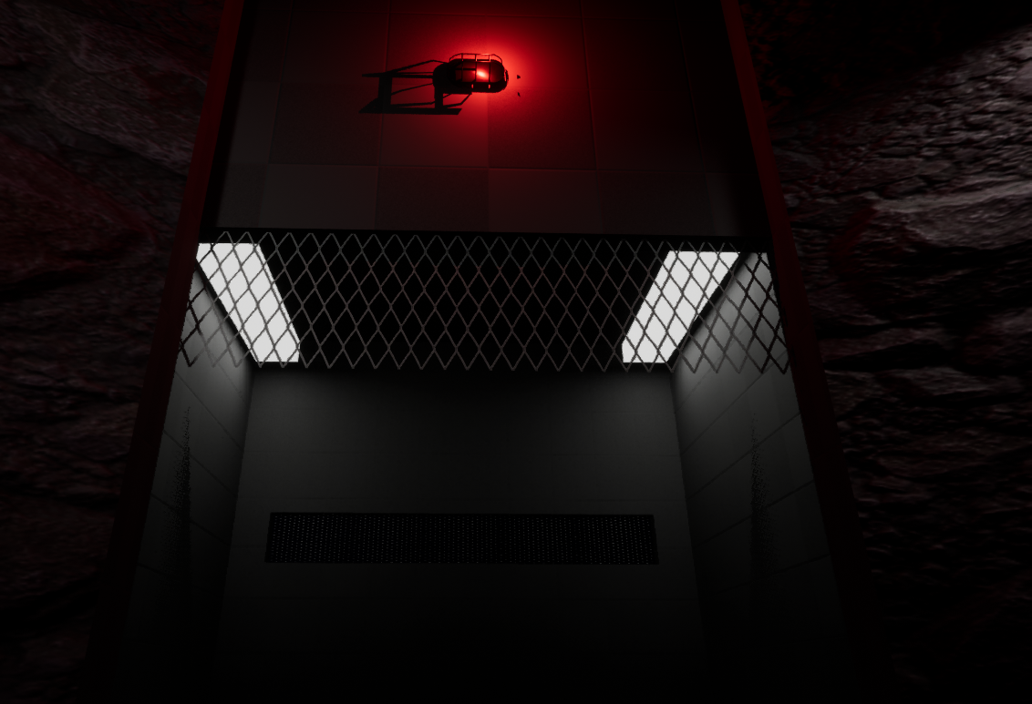
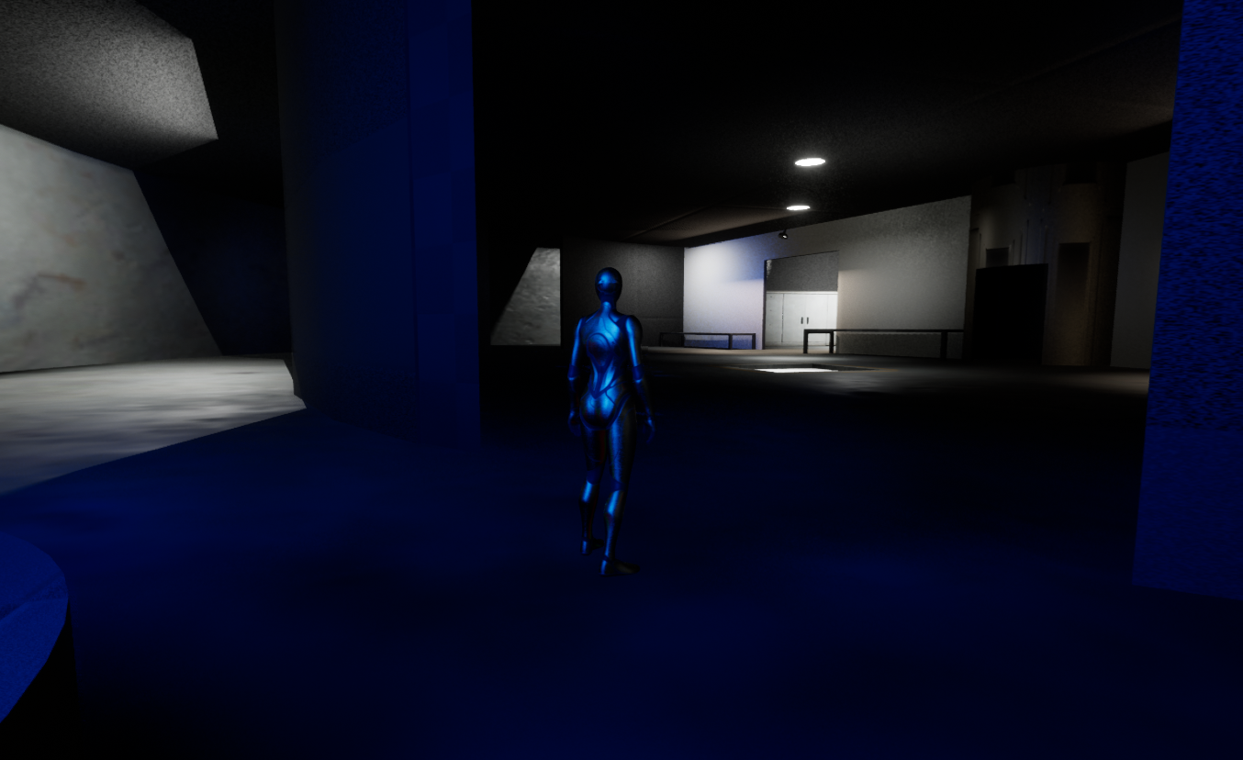
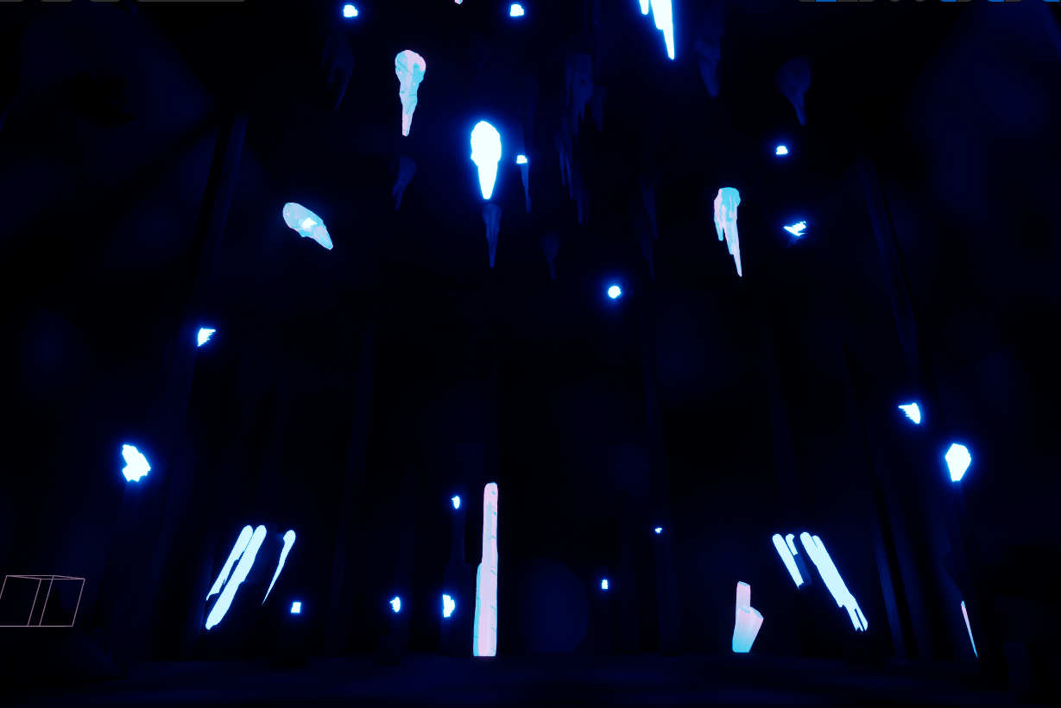
MAPS

Slide 19
Concept art
Ani, Michael

Slide 20
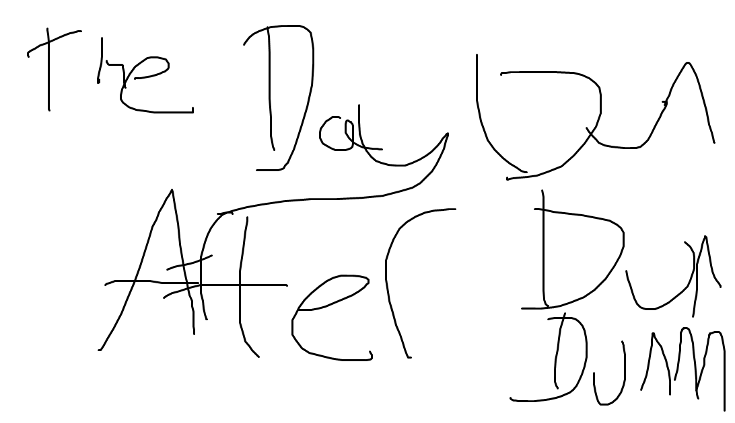
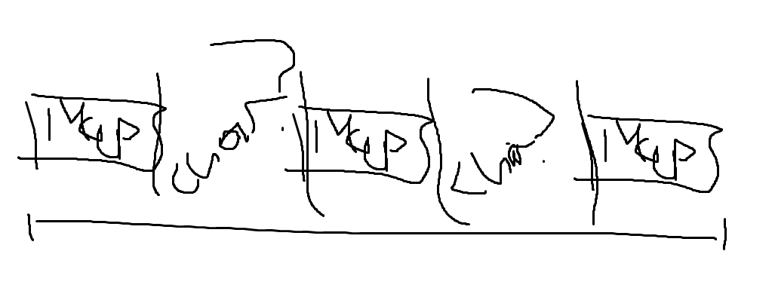
Concept Art

Slide 21

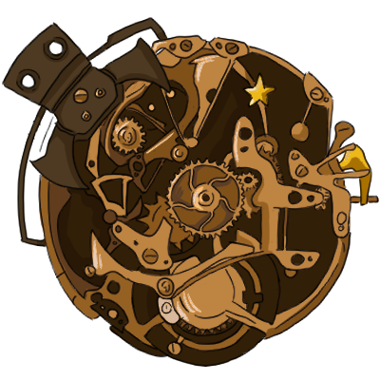
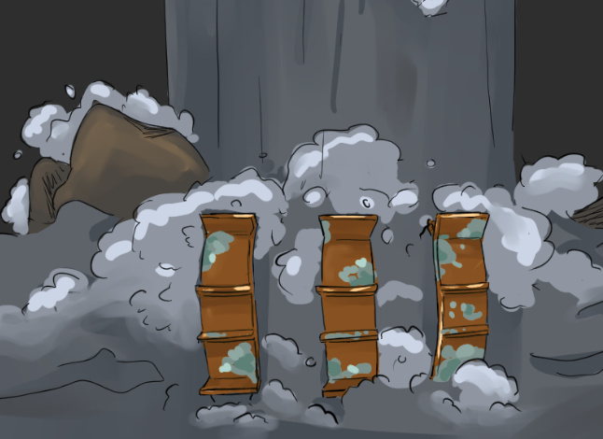

Concept Art

Slide 22
Graphical UI
Ronak, Toby, Thomas, Jacob

Slide 23
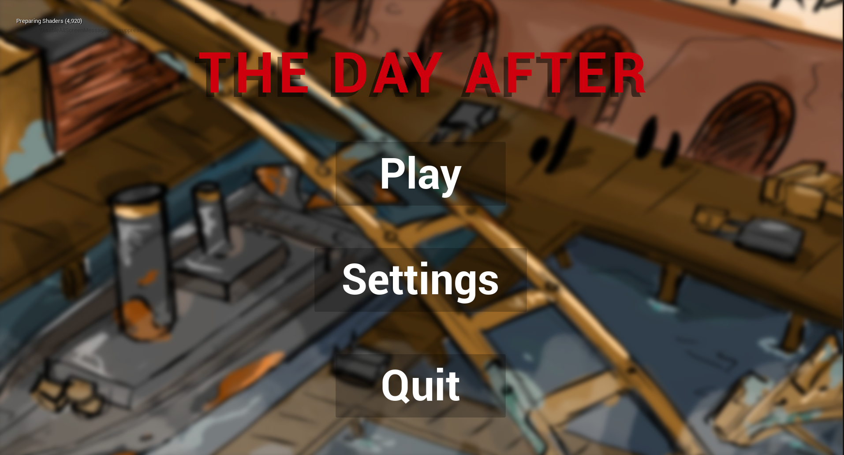
Menu and UI

Slide 24
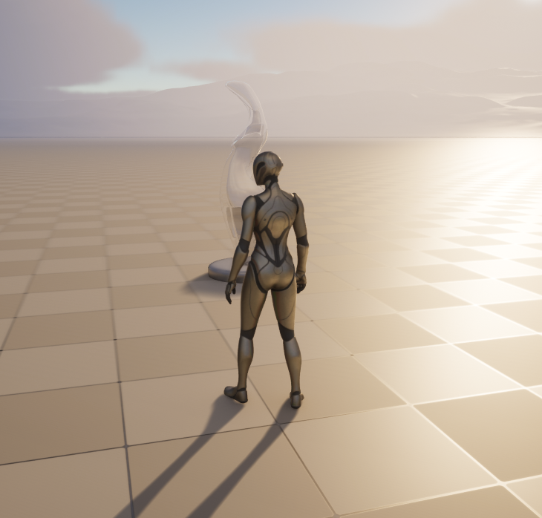
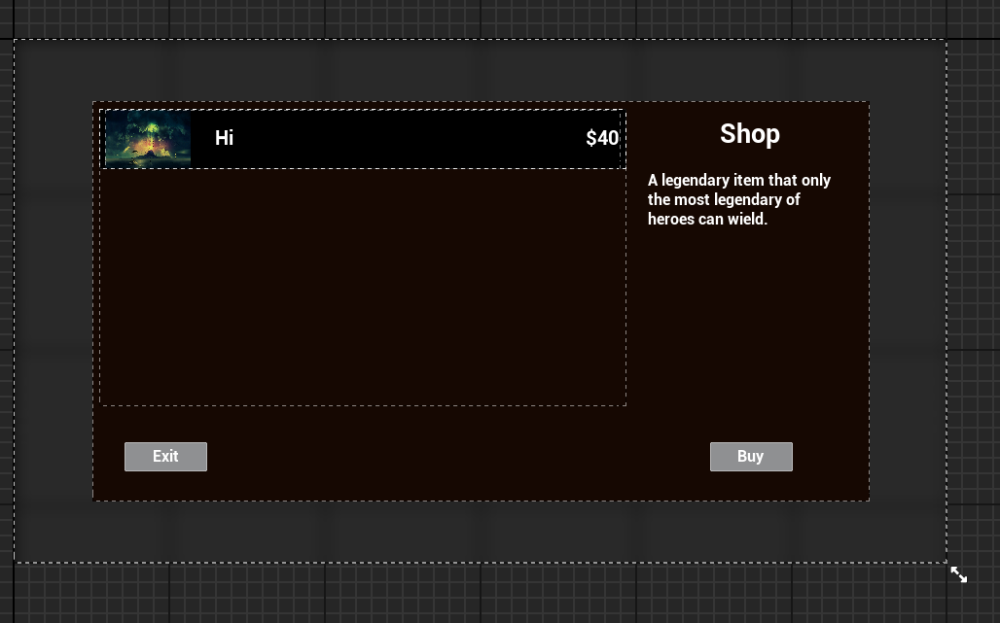
SHOP MENU

Slide 25
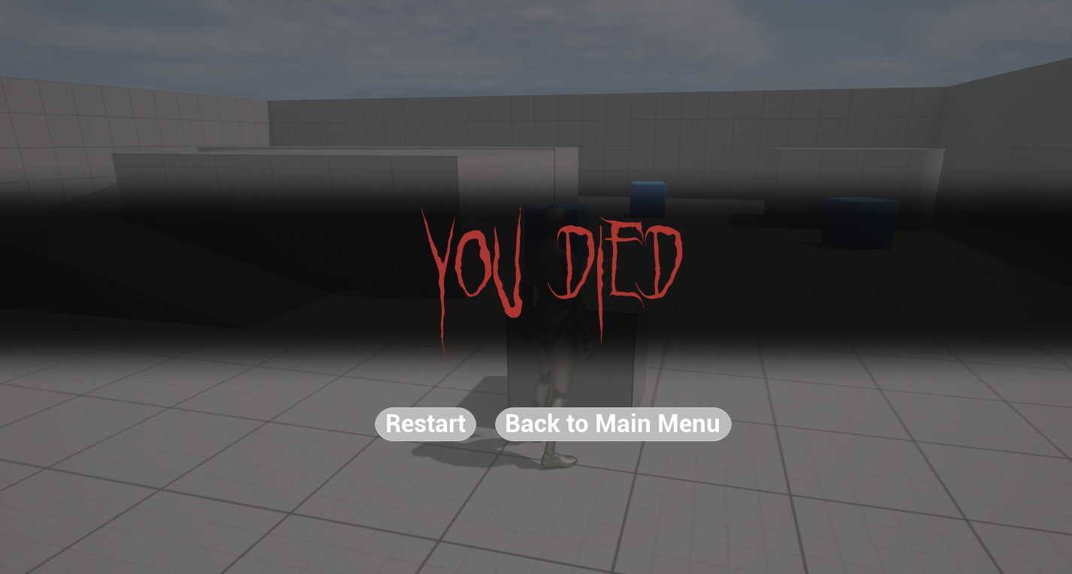
Death Screen

Slide 26

Menu and UI

Slide 27
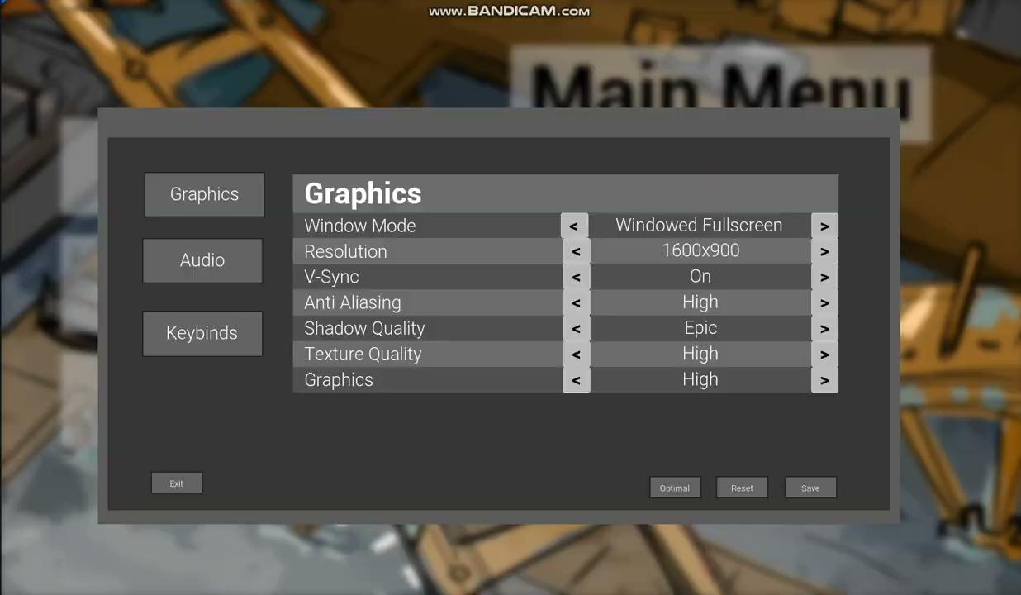
Settings Menu

Slide 28
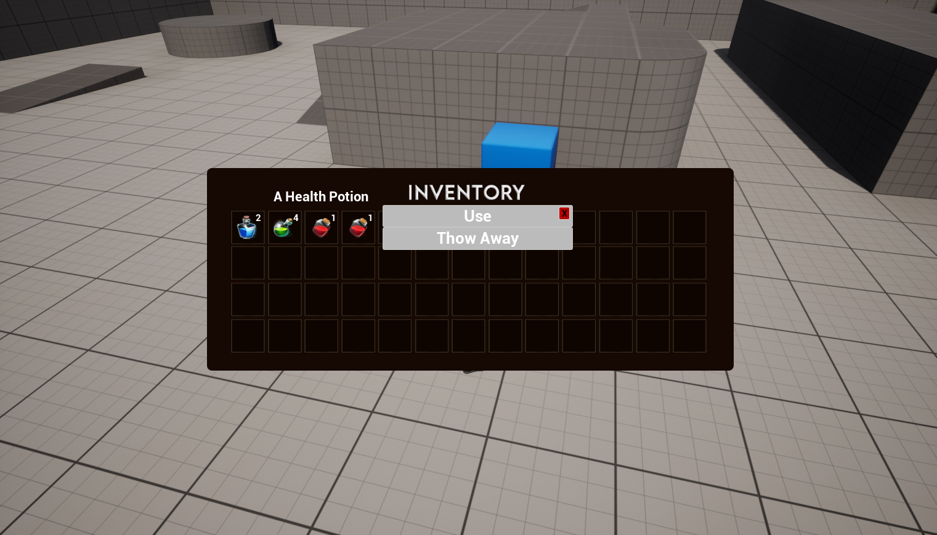
Inventory
Previous Iteration:

Slide 29
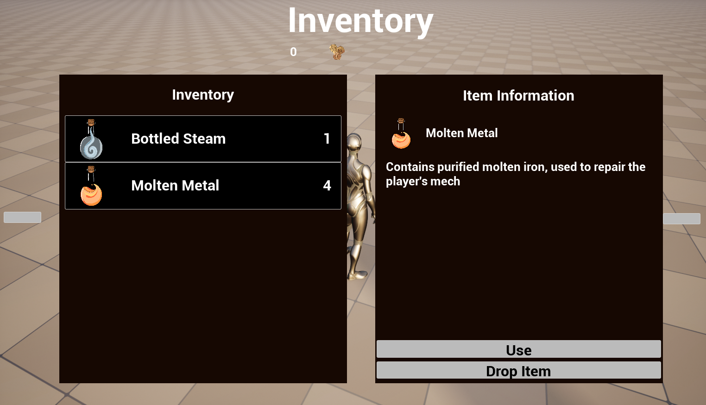
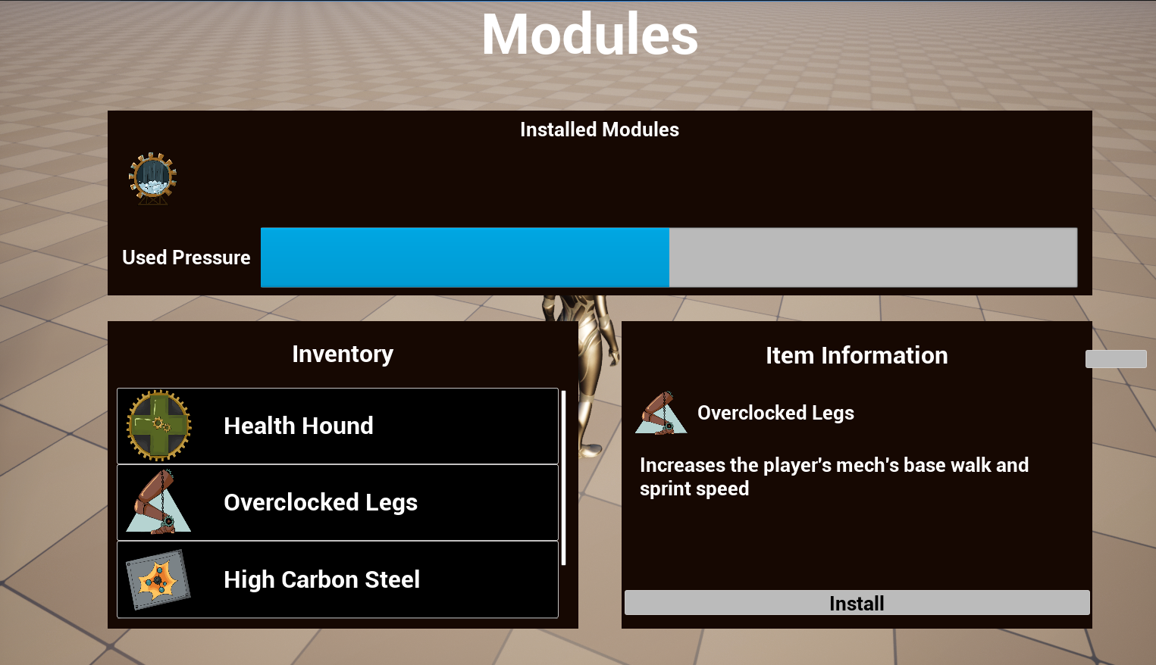
Inventory
Current Iteration:

Slide 30
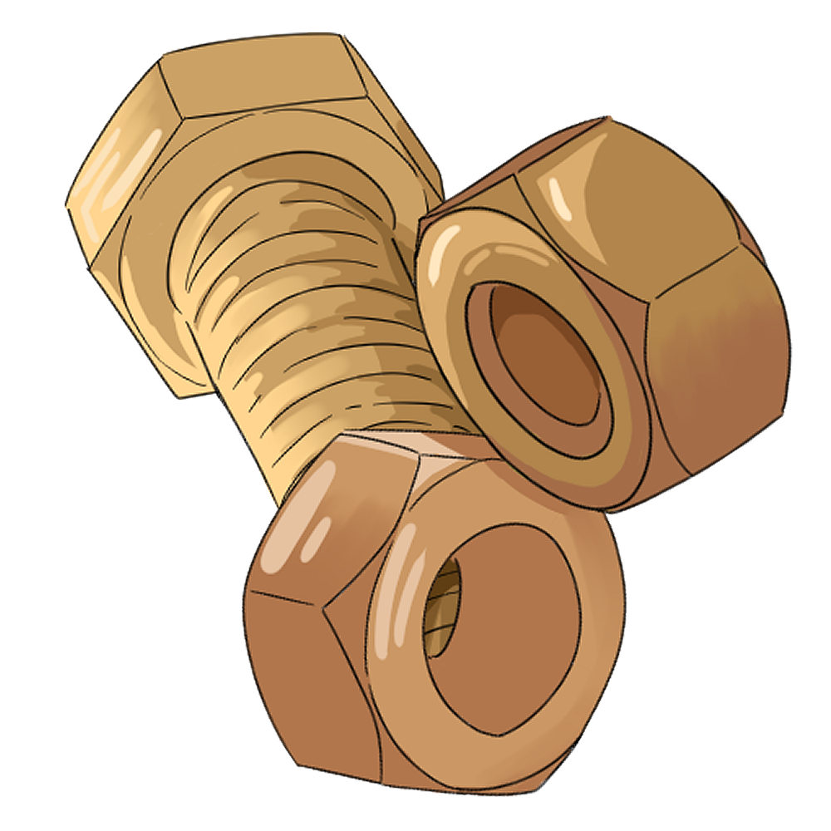


Inventory Items
Scrap: Currency of the game. Composed of a random assortment of nuts, bolts, and loose parts
Molten Metal: A small bottle of molten metal. Can be applied to the player mech to repair damage.
Bottled Steam: A small bottle of warm steam. Quickly refills the steam stored by the player’s mech.

Slide 31

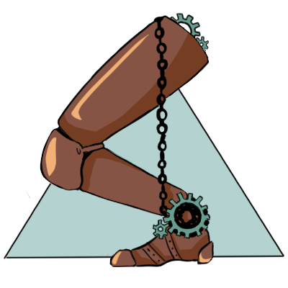
Modules
Piston Arms: Module which increases the player’s melee attack range
Overclocked Legs: Module which increases the player’s walking and sprinting speed
Gear Replication Device: Module which increases the amount of scrap the player receives

Slide 32
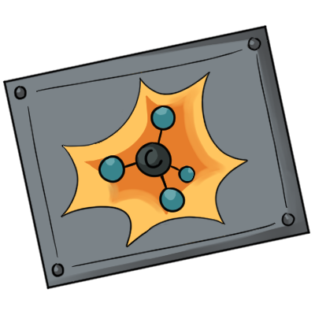

Modules
High Carbon Steel: Module which increases the maximum health available to the player
Wetter Water: Module which increases the rate at which the player regains pressure
Health Hound: Module which repairs the player’s mech by 5% of all damage dealt

Slide 33
Modules

Slide 34
CutScenes
Sofia, Jordan

Slide 35
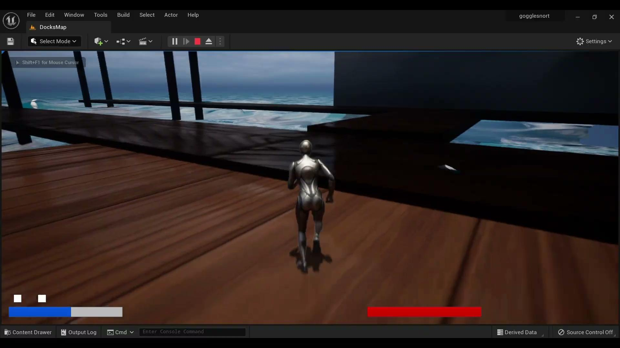
End cutscene

Slide 36
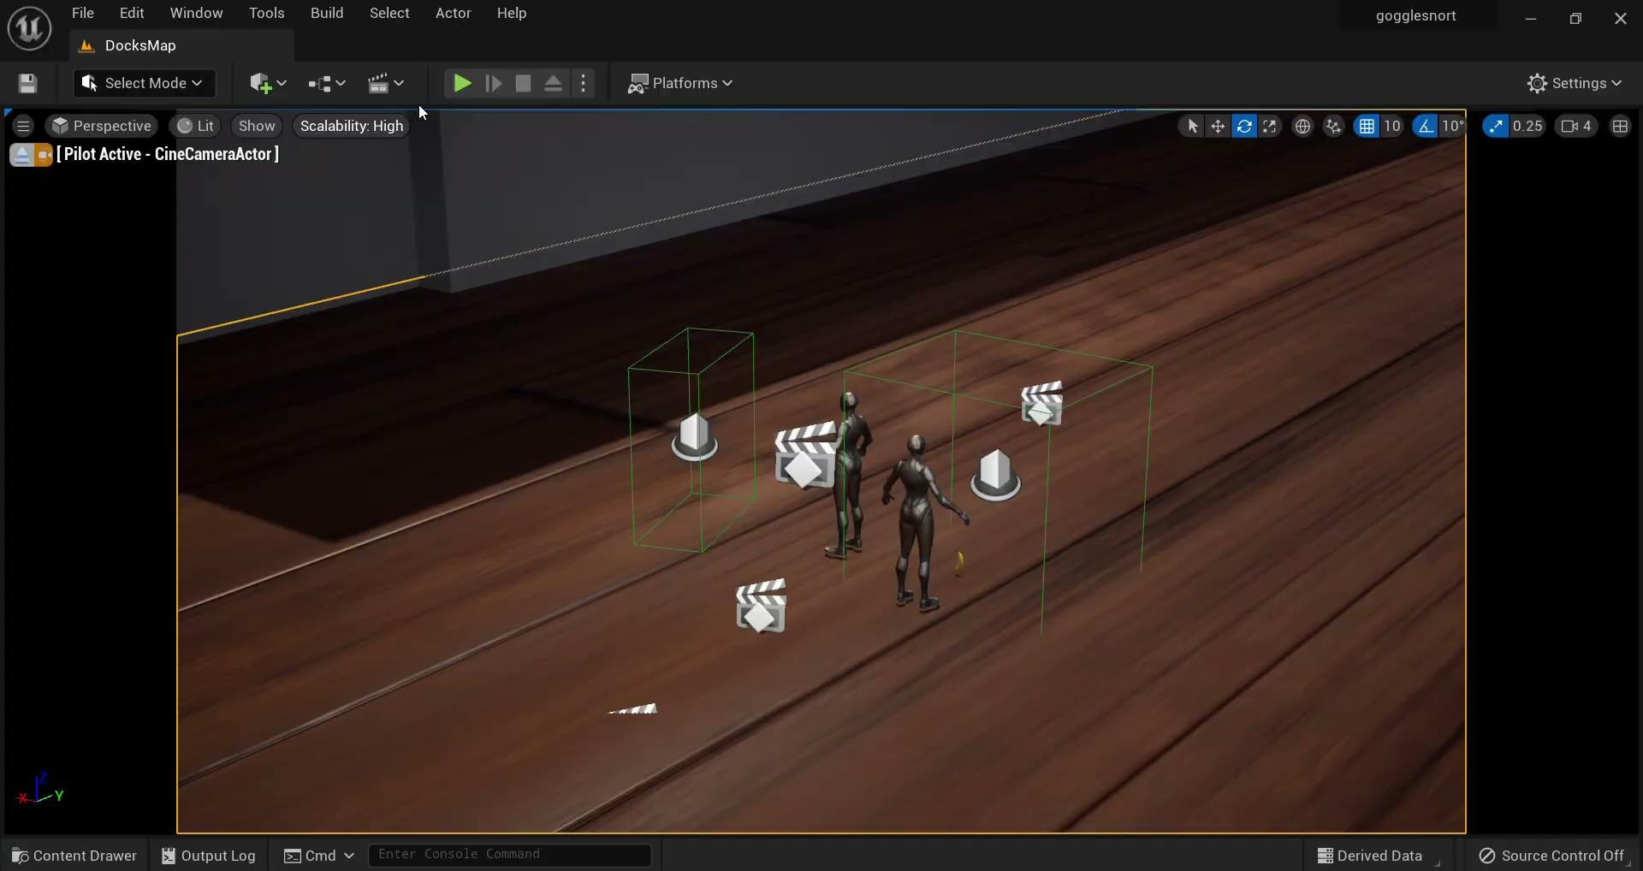
Action cutscene

Slide 37
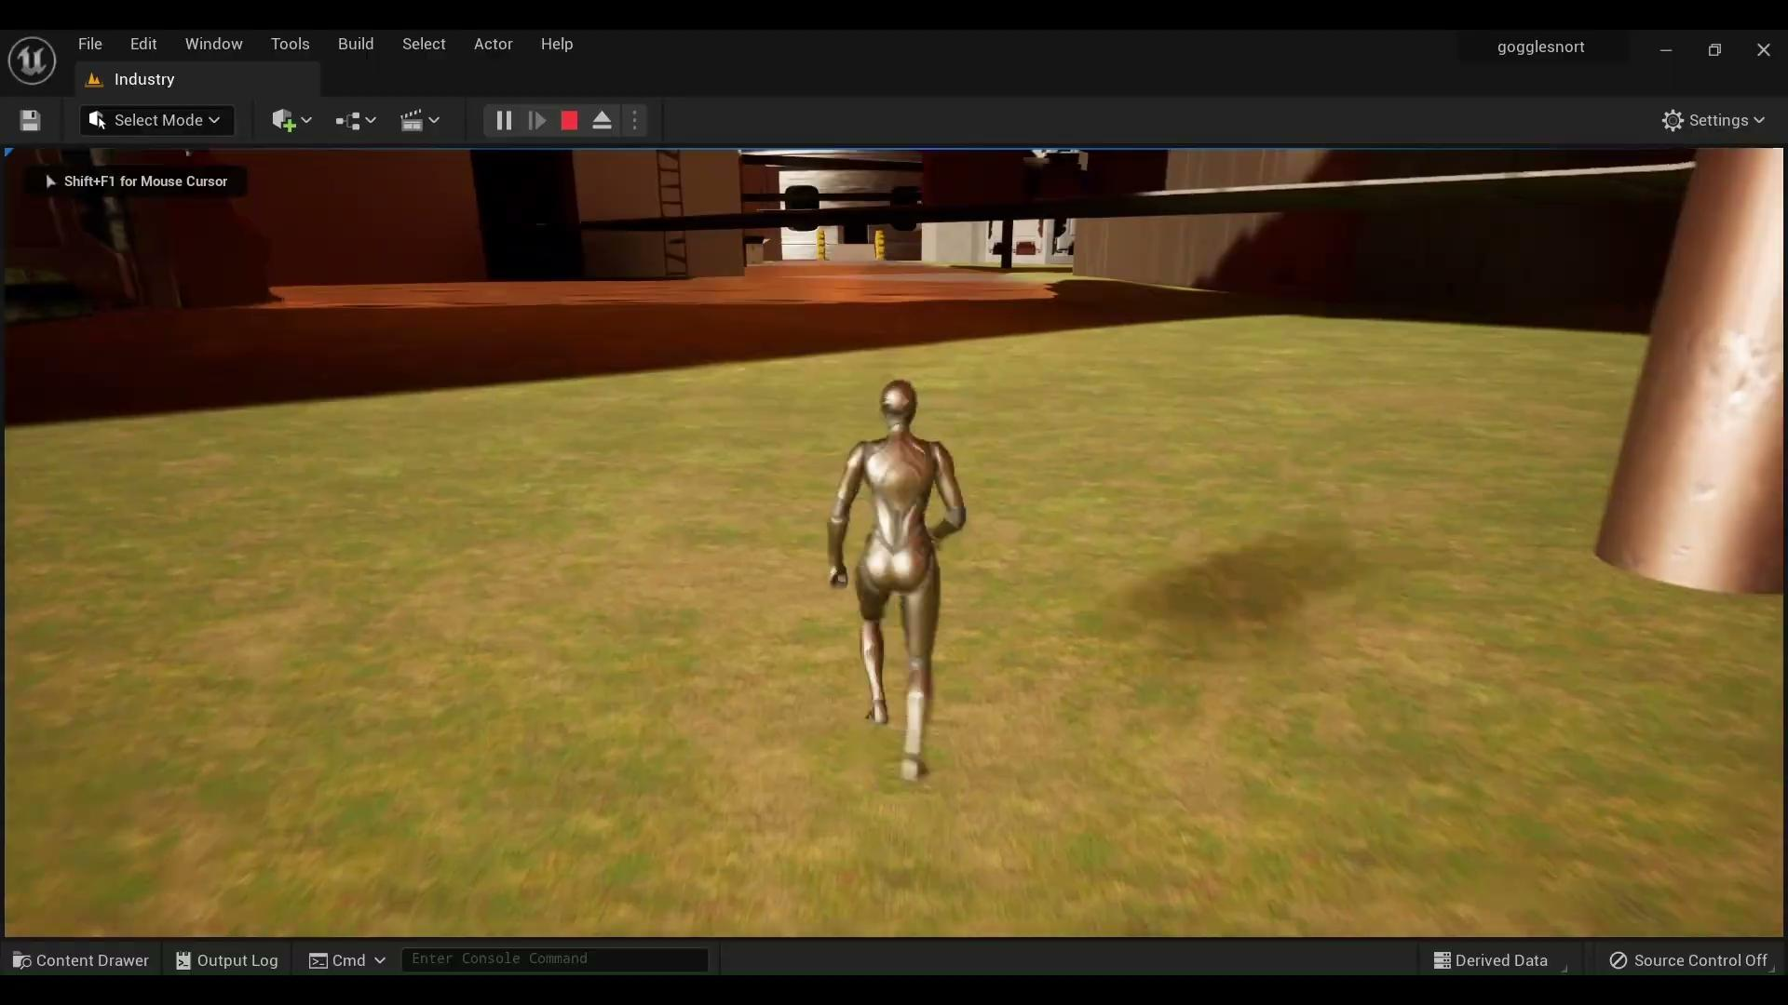
Industry Map cutscene

Slide 38
Questing
Thomas

Slide 39
Questing

Slide 40
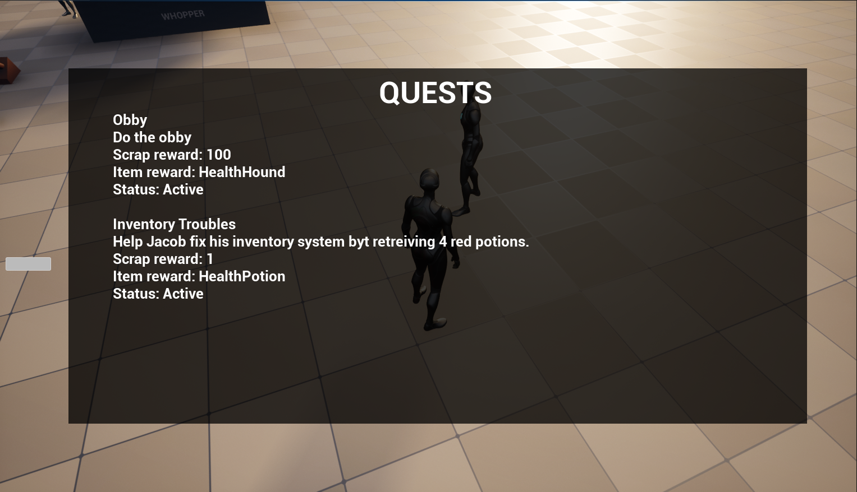
Questing menu

Slide 41
Movement
Michael, Jordan, Sofia, Ethan

Slide 42
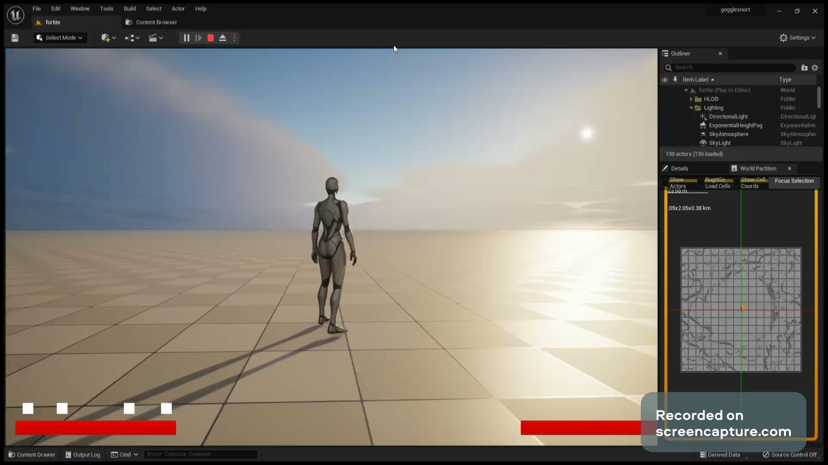
Super jump

Slide 43
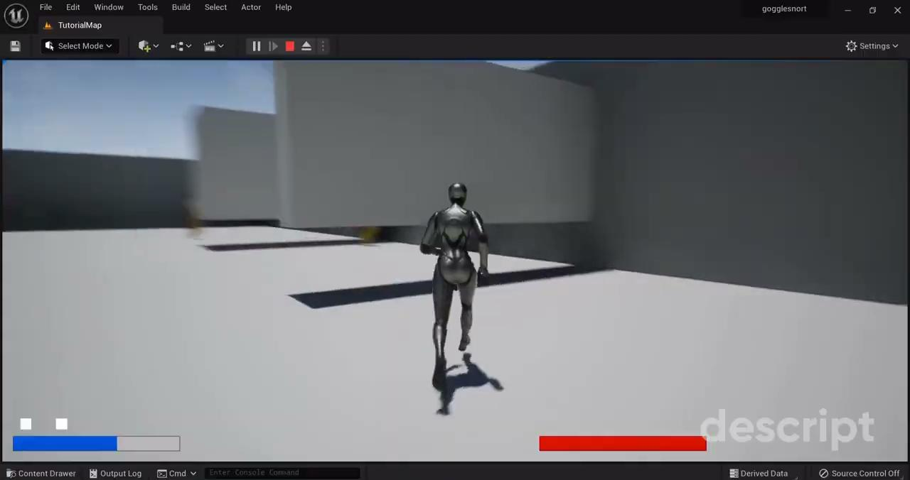
Slide

Slide 44
Weapons
Adam, Drew, Arpeet

Slide 45
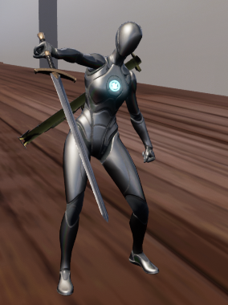
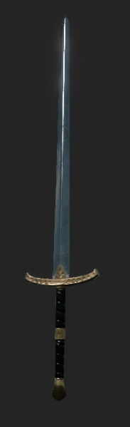
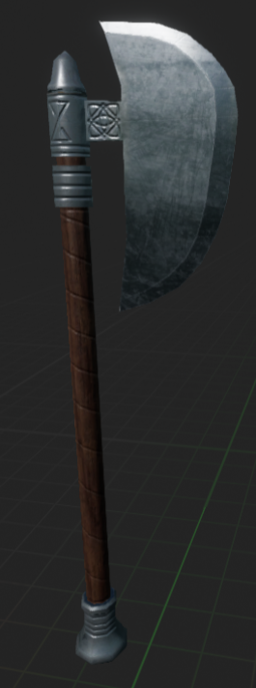
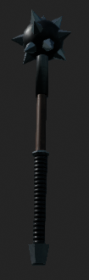
Melee Weapons

Slide 46
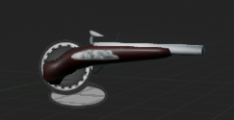
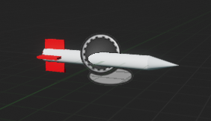



Ranged Weapons

Slide 47

Weapon Showcase

Slide 48
Enemies & Bosses
Ellison, Jaden, Michael, Umar

Slide 49



Enemies
Jaden’s Patroller
Jaden’s Mage
Ellison’s Sniper
Umar’s Fighter

Slide 50

Bosses

Slide 51

Bosses

Slide 52

Bosses

Slide 53
Rekab

Slide 54


Baker

